Slide 1

Summer internship project
Heartbeat sound classification
Submitted by-
Mehul Tyagi Aman Mishra
170101024 170101008

Slide 2
introduction

Slide 3
Need for a Machine Learning model over traditional methods.
Stethoscope detection currently provides one of the first warning signs of heart disease. During this procedure, which usually occurs in one’s annual physical examination, physicians manually listen for and identify irregularities in heart sounds that indicate a need for further investigation.
Early detection and intervention in heart disease greatly improves the lifespan and the effectiveness of treatment options. For this reason, the benefits of placing the first-detection capability in the hands of the individual are immense.
This project aims to use machine learning methods to identify and classify heartbeat sounds from audio collected from digital stethoscopes and mobile devices available to the average consumer.

Slide 4
Background

Slide 5
Some Insight into Heart Sounds
Different heart-sounds, resulting from mechanical cardiac events and heard from stethoscope examinations, can be indicators for various cardiac health concerns. Typically, a heartbeat creates two sounds, lub-dub, that can be heard through a stethoscope. These sounds are termed, respectively, S1 and S2 for the first and second heart sounds within one beat. S1 occurs when the mitral and tricuspid valves close at the end of systole, when blood from the atriums fill into the ventricles. S2 is heard when aortic and pulmonic valve leaflets close after diastole, after blood is pushed out from the ventricles. These two sounds make up what a normal heartbeat should sound like.
When abnormalities occur in cardiac physiology, they are oftentimes reflected in heartbeat sounds. A few of the most commonly occurring abnormal sounds, the ones that this project will be identifying and classifying, are heart murmurs, extrasystole, extra heart sounds, and artifact sounds. Murmurs are extra sounds that occur when there is turbulence in blood flow that causes the extra vibrations that can be heard. Extrasystole is a premature contraction of the heart that causes an extra sound before S1 and palpitations due to abnormal electrical circuitry within the heart. Extra heart sounds occur after diastole, S2, due to sudden deceleration of blood, caused by abnormalities in cardiac muscle physiology that affects contraction characteristics

Slide 6
setup

Slide 7
DATASETS
Two different datasets are used to verify the performance of the machine learning models.
Dataset A has four classes with 120 total samples. The four classes are artifact, extra heart sound, murmur and normal heartbeat.
Dataset B has fewer classes and more samples, sampling heart sounds at 4000 samples per second. This dataset consists of three classes and a total of 461 samples, 149 of which are noisy.
The three classes are extrasystole, murmur and normal heartbeat. These two different datasets are used to verify the generalizability of the machine learning models, as well as to compare both dataset results.

Slide 8
PREPROCESSING
The pre-processing includes removing audio files that are less than 2 seconds, down sampling, removing high frequency noise and normalizing the data.
Files more than 12 seconds were trimmed down and files less than 2 seconds are removed because those files do not capture a full heartbeat cycle, making it impossible to extrapolate whether or not those samples contain heart sound irregularities.
For dataset A, a total of 120 samples are used and for dataset B, a total of 407 samples are used.

Slide 9
Feature extraction

Slide 10
What all is actually needed.
For feature extraction, the signals were analyzed in two groups. For the first group of extractions, the entire signal was analyzed in both the time and frequency domain. The second group uses significant parts of the signal as a whole to extract features.
The significant parts of a signal are S1 and S2. A total of 18 different features were extracted, seven of which are based on the entire signal. The features extracted for the first set of features in the time domain are zero crossings, energy and entropy of energy.
In the frequency domain, spectral spread, spectral entropy, spectral flux and Mel Frequency Cepstral Coefficients (MFCCs) were used. All sound features were extracted using librosa, a python library for audio signal analysis.

Slide 11
Categories of heartbeat

Slide 12

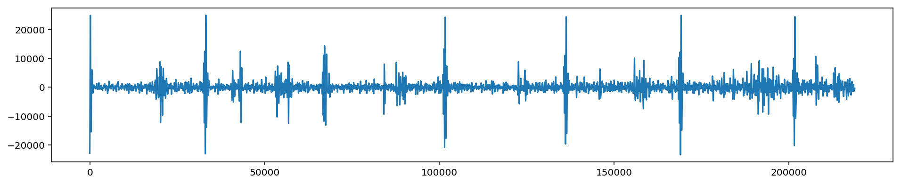
1. Normal case
In the Normal category there are normal, healthy heart sounds. These may contain noise in the final second of the recording as the device is removed from the body. They may contain a variety of background noises (from traffic to radios). They may also contain occasional random noise corresponding to breathing, or brushing the microphone against clothing or skin.
A normal heart sound has a clear “lub dub, lub dub” pattern, with the time from “lub” to “dub” shorter than the time from “dub” to the next “lub” (when the heart rate is less than 140 beats per minute)(source: Rita Getz)

Slide 13
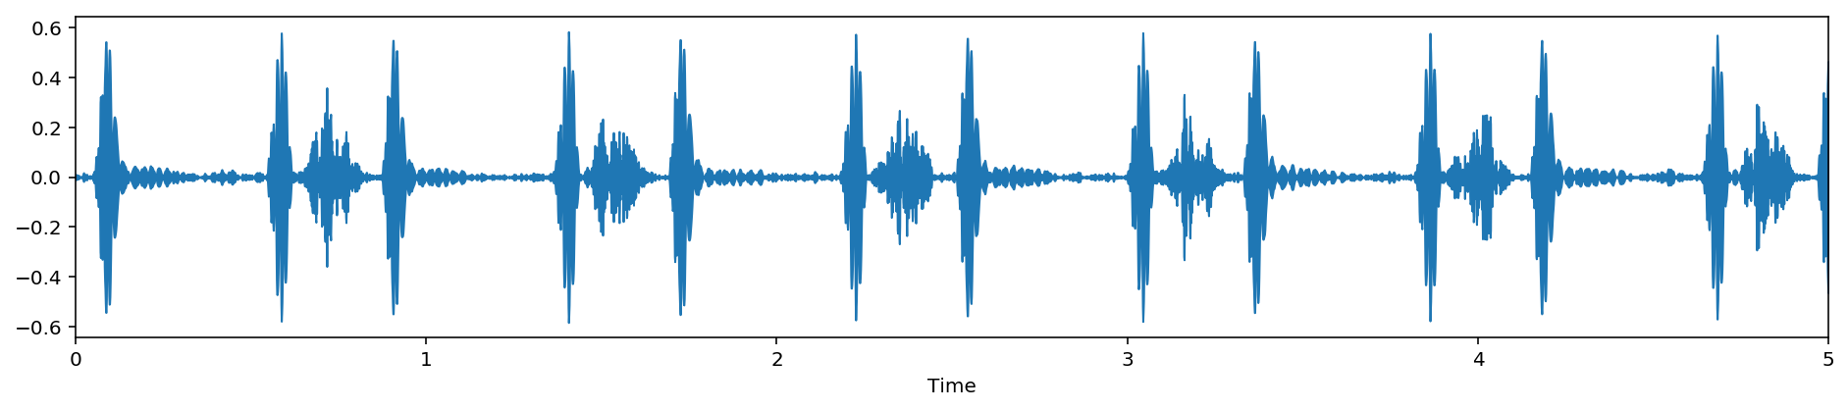
2. Murmur
Heart murmurs sound as though there is a “whooshing, roaring, rumbling, or turbulent fluid” noise in one of two temporal locations: (1) between “lub” and “dub”, or (2) between “dub” and “lub”. They can be a symptom of many heart disorders, some serious. There will still be a “lub” and a “dub”.
One of the things that confuses non-medically trained people is that murmurs happen between lub and dub or between dub and lub; not on lub and not on dub.(source: Rita Getz)

Slide 14
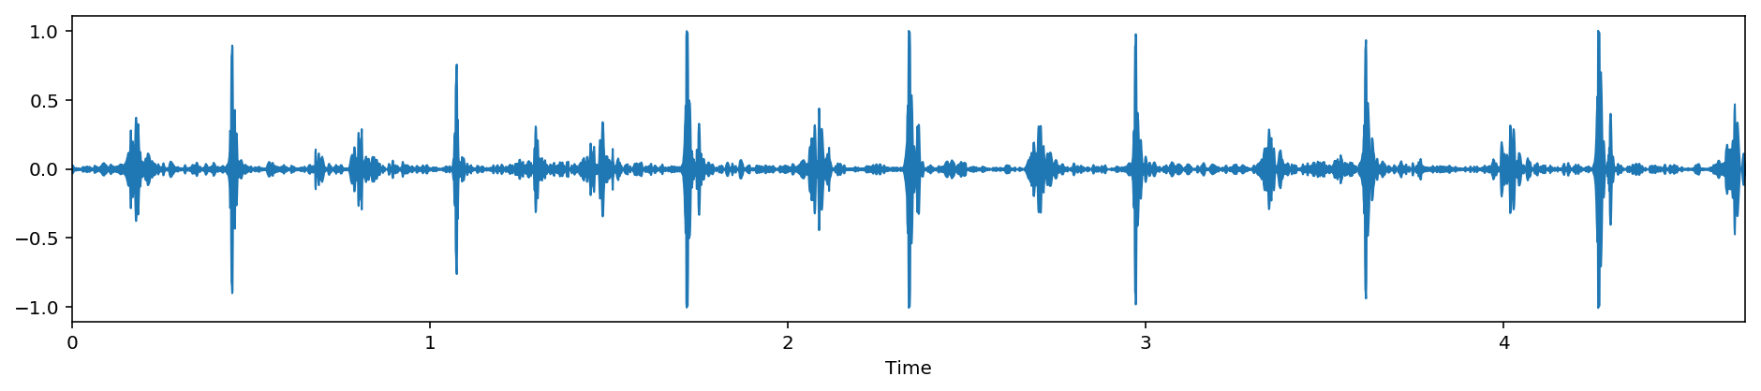
3. Extrasystole
Extrasystole sounds may appear occasionally and can be identified because there is a heart sound that is out of rhythm involving extra or skipped heartbeats, e.g. a “lub-lub dub” or a “lub dub-dub”. (This is not the same as an extra heart sound as the event is not regularly occuring.)
An extrasystole may not be a sign of disease. It can happen normally in an adult and can be very common in children. However, in some situations extrasystoles can be caused by heart diseases. If these diseases are detected earlier, then treatment is likely to be more effective. (source: Rita Getz)

Slide 15
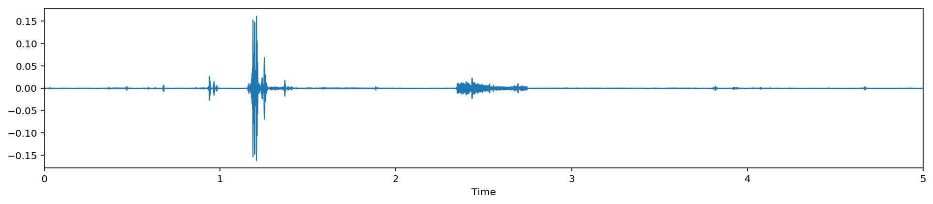
4. Artifact
In the Artifact category there are a wide range of different sounds, including feedback squeals and echoes, speech, music and noise. There are usually no discernable heart sounds, and thus little or no temporal periodicity at frequencies below 195 Hz.
This category is the most different from the others. It is important to be able to distinguish this category from the other three categories, so that someone gathering the data can be instructed to try again.(source: Rita Getz)

Slide 16
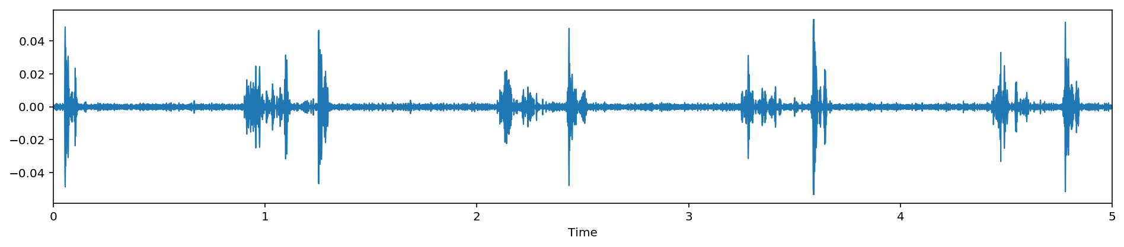
5. Extra Heart Sound
Extra heart sounds include the third and fourth heart sounds. The third heart sound (S3) is a mid-diastolic, low-pitched sound. With the presence of S3, the heart sounds are described as having a gallop rhythm, simply because its addition alongside S1 and S2 make it sound like a horse galloping.
Extra sounds, (3rd and/or 4th), can be normal, esp. in children. It can occur also while some severe exercise, but are generally heard when ventricular function is impaired, e.g., in case of acute infarction or severe cardiac failure.

Slide 17
Methods & Features

Slide 18
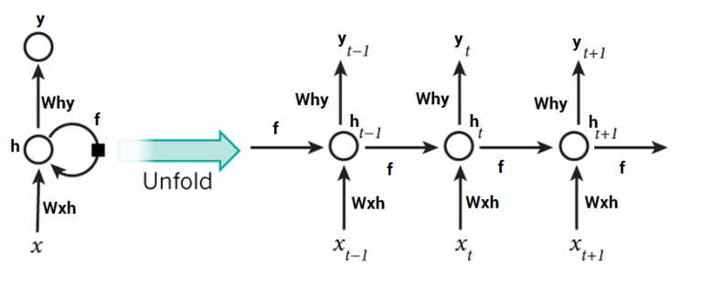
LSTM
LSTM network is comprised of different memory blocks called cells. There are two states that are being transferred to the next cell; the cell state and the hidden state. The memory blocks are responsible for remembering things and manipulations to this memory is done through three major mechanisms, called gates.
The advantage of an LSTM cell compared to a common recurrent unit is its cell memory unit. The cell vector has the ability to encapsulate the notion of forgetting part of its previously stored memory, as well as to add part of the new information.

Slide 19
Sound feature: mfcc
In sound processing, the mel-frequency cepstrum (MFC) is a representation of the short-term power spectrum of a sound, based on a linear cosine transform of a log power spectrum on a nonlinear mel scale of frequency.
Mel-frequency cepstral coefficients (MFCCs) are coefficients that collectively make up an MFC. They are derived from a type of cepstral representation of the audio clip (a nonlinear "spectrum-of-a-spectrum").
The difference between the cepstrum and the mel-frequency cepstrum is that in the MFC, the frequency bands are equally spaced on the mel scale, which approximates the human auditory system's response more closely than the linearly-spaced frequency bands used in the normal cepstrum. This frequency warping can allow for better representation of sound, for example, in audio compression.

Slide 20
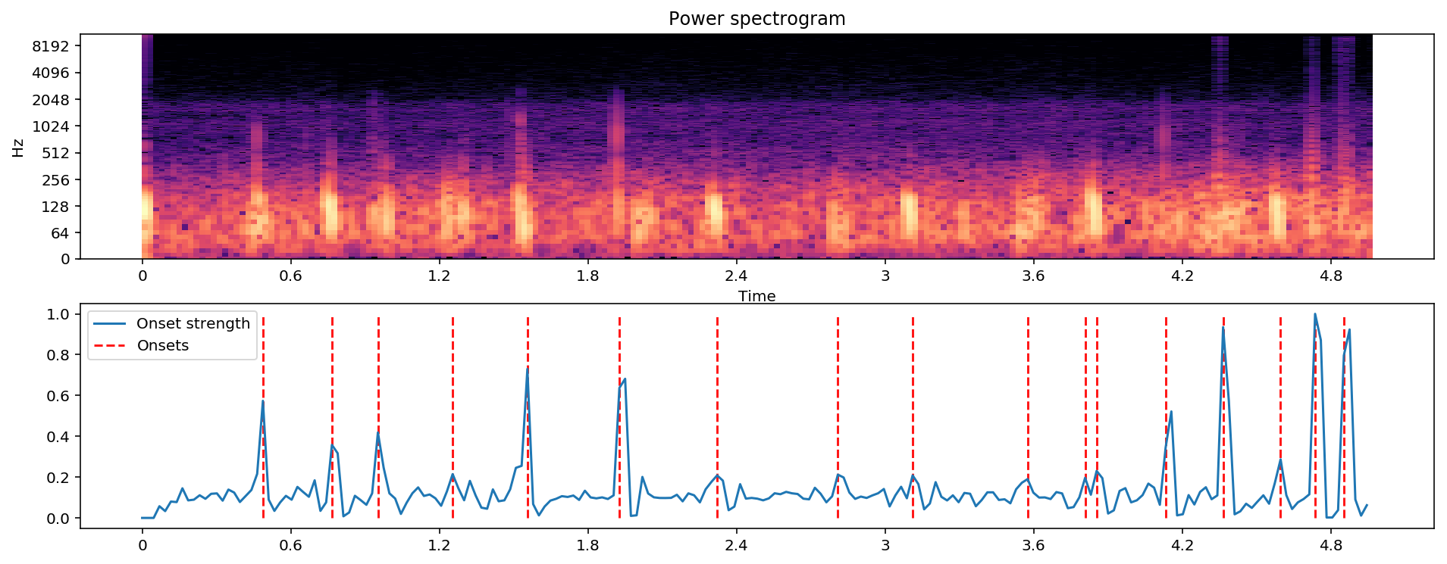

Sound feature: onset detector
Basic onset detector locates and notes onset events by picking peaks in an onset strength envelope. The peak _pick parameters were chosen by large-scale hyper-parameter optimization over the dataset provided

Slide 21
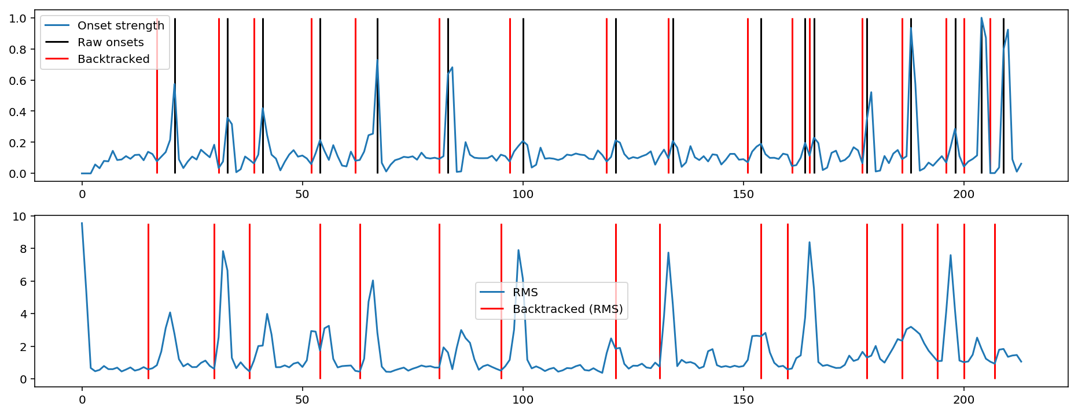
Sound feature: onset backtrack
Backtrack detected onset events to the nearest preceding local minimum of an energy function. This function can be used to roll back the timing of detected onsets from a detected peak amplitude to the preceding minimum. This is most useful when using onsets to determine slice points for segmentation.

Slide 22
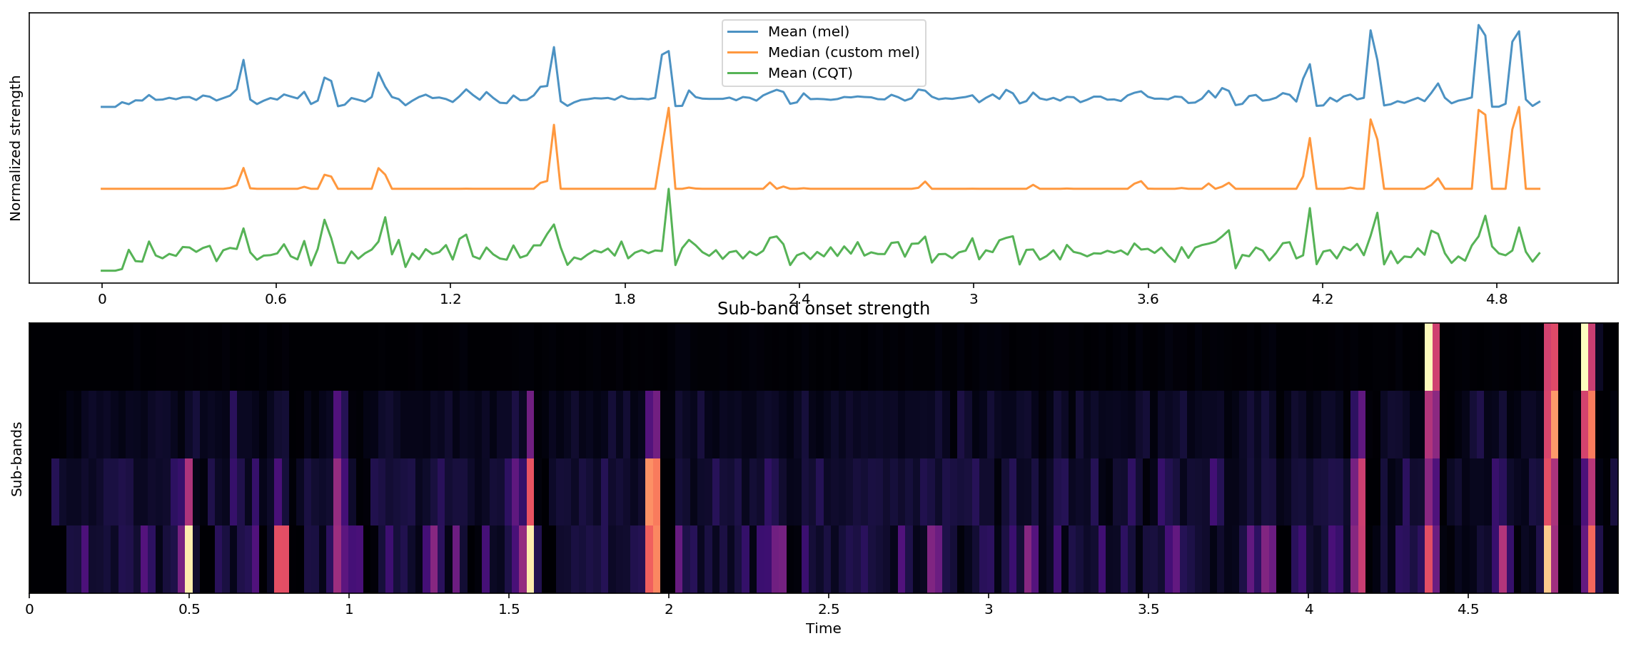
Sound feature: onset strength
Computing a spectral flux onset strength envelope.
Onset strength at time t is determined by:
mean max(0, S[f, t] - ref_S[f, t - lag])
where S is pre-computed (log-power) Mel spectrogram and ref_S is S after local max filtering along the frequency axis.

Slide 23
Implementations

Slide 24
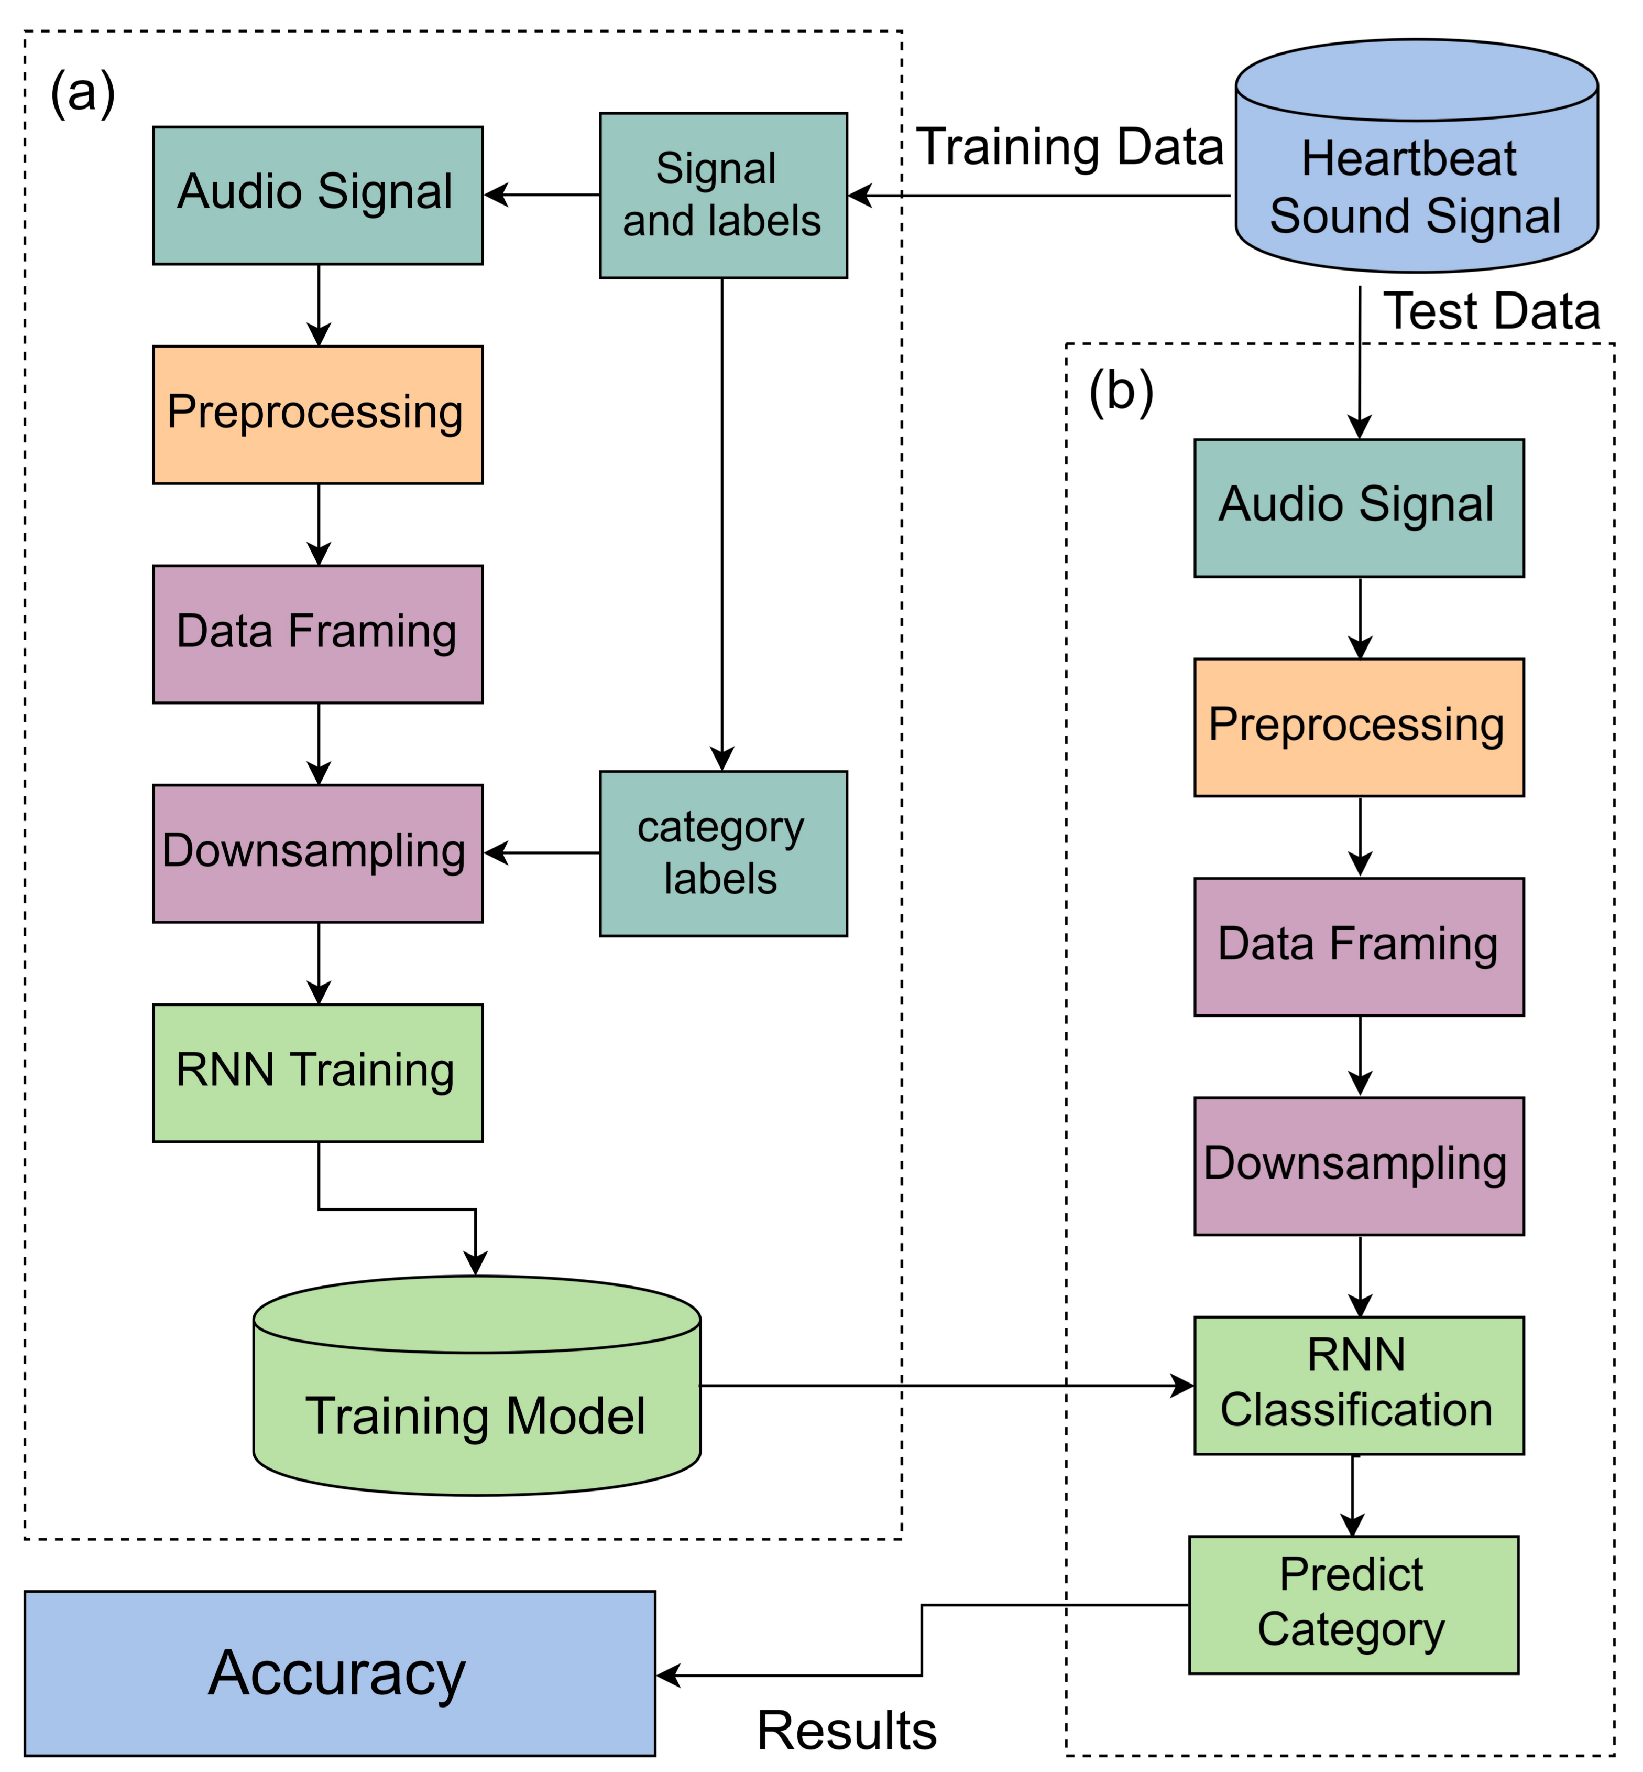

Slide 25
Conclusion

Slide 26

The process of classifying audio heart sounds was completed using the Machine Learning Algorithms. Two audio heart sound datasets are used to train and verify the six chosen methods. The process to classify heartbeats includes preprocessing the datasets, extracting audio features, training methods and finally analyzing results.
Firstly preprocessing was done to normalize the data. Then feature extraction uses this preprocessed data to extract features using the whole signal and significant parts of the signal, such as S1 and S2. Using the feature extracted, we build our LSTM model. After the compilation of which, we can determine the category of any unlabeled heart sounds.
Our Model was successful to get an accuracy of 79 % to predict the correct category of the unlabeled Heart Sound. As for the future objective, we will keep trying to improve the accuracy scores of our LSTM model.

Slide 27
Thank You

